Slide 1
TASSEL Workshop
January 2021
Prabin Bajgain & Sushan Ru

Slide 2
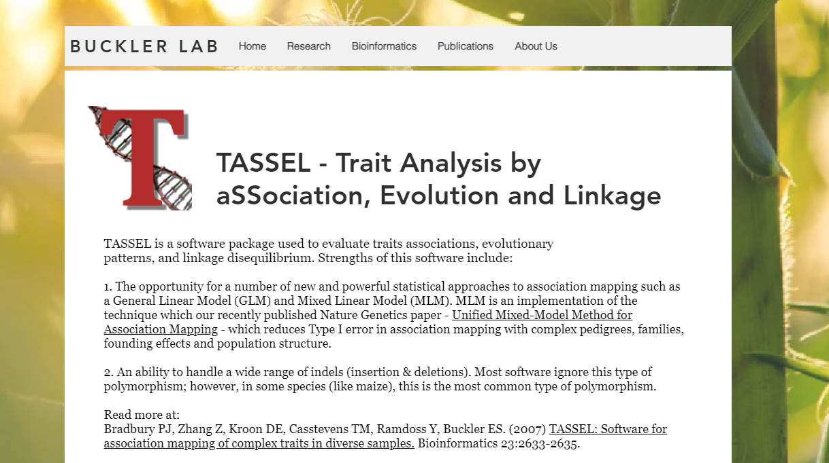
https://www.maizegenetics.net/tassel

Slide 3
What can TASSEL do?
Genotype and phenotype data editing
File conversion (e.g., hapmap, VCF, Plink)
Merging, sorting, filtering
Phenotype transformation
Genotyping-by-sequencing (GBS) pipeline
GBS v2 pipeline
UNEAK
Data imputation
LD KNNi
Numerical
FILLIN, FSFHAP
Pan-genome analysis
PanA
Genetic analysis
Diversity
Relatedness
Genotype/phenotype association
GWAS
Genomic selection

Slide 4
What can TASSEL do?
Genotype and phenotype data editing
File conversion (e.g., hapmap, VCF, Plink)
Merging, sorting, filtering
Phenotype transformation
Genotyping-by-sequencing (GBS) pipeline
GBS v2 pipeline
UNEAK
Data imputation
LD KNNi
Numerical
FILLIN, FSFHAP
Pan-genome analysis
PanA
Genetic analysis
Diversity
Relatedness
Genotype/phenotype association
GWAS
Genomic selection

Slide 5
Schedule
8:00am - 8:30am: Tassel overview, resources (Sushan) 8:30am - 09:30am: Data conversion, imputation* (Sushan) 9:30am - 9:45am: Break 9:45am - 11:30am: LD, PCA, Kinship, GWAS* (Prabin) 11:30am - 12:00pm: Questions & Wrap-up (Prabin & Sushan)

Slide 6
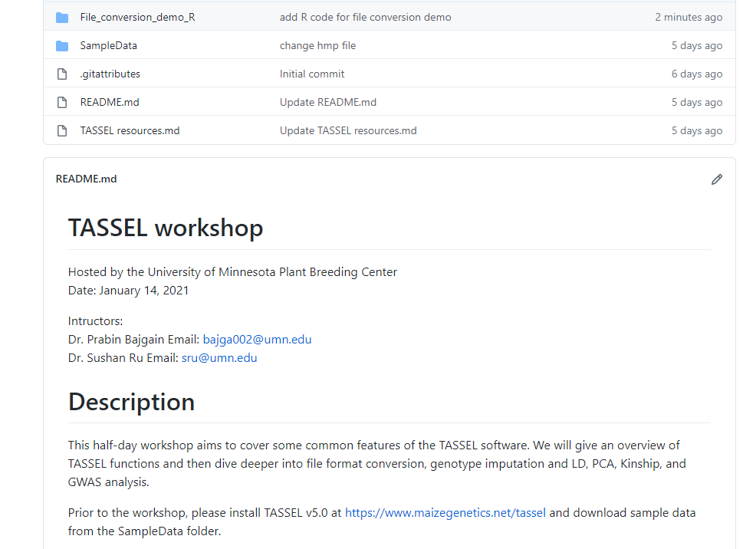
GitHub page
https://github.com/SushanRu/TASSEL-workshop

Slide 7
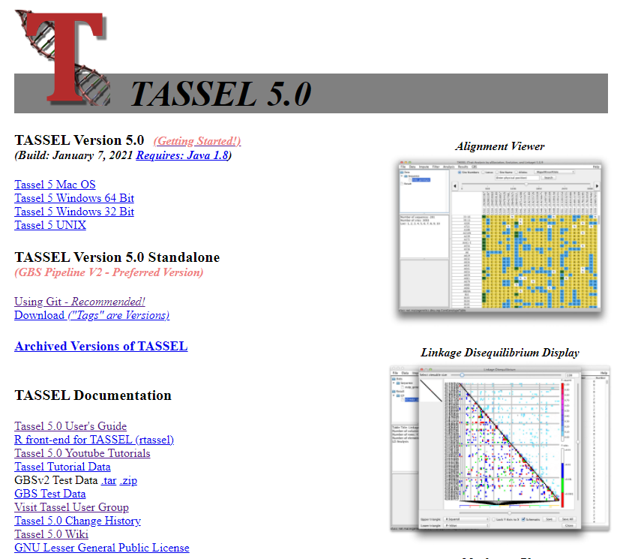
Installation
Homepage: software download & other information
https://www.maizegenetics.net/tassel

Slide 8
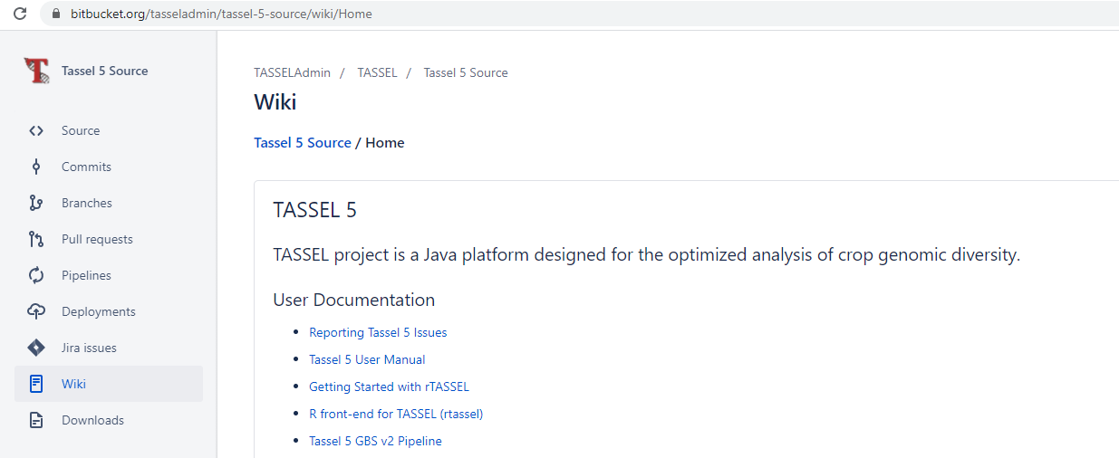
Resources
Wiki: User manual & software information
https://bitbucket.org/tasseladmin/tassel-5-source/wiki/Home
User manual
https://bitbucket.org/tasseladmin/tassel-5-source/wiki/UserManual

Slide 9

Resources
YouTube Tutorials
https://www.youtube.com/channel/UCS1SdXlyMI1OsSf5yA_oFqw

Slide 10
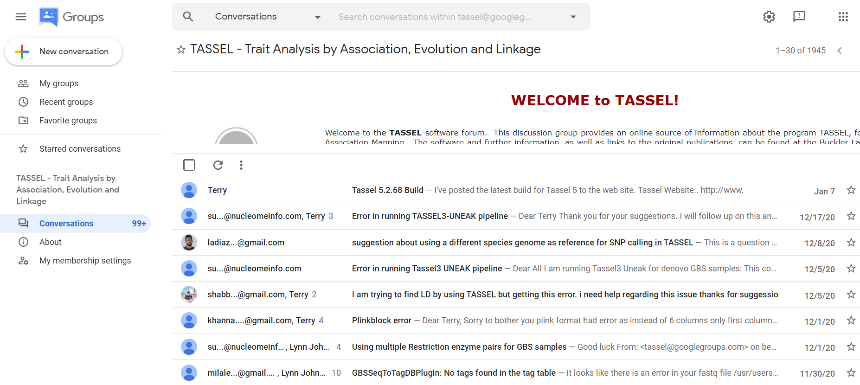
Resources
TASSEL - Google Groups
https://groups.google.com/g/tassel

Slide 11
File conversion

Slide 12
GitHub page
https://github.com/SushanRu/TASSEL-workshop

Slide 13
Genotype file format
Hapmap
VCF
Plink
Flapjack
…

Slide 14
Genotype file format
Common output format from genotyping
Common input format required by
e.g., database, imputation software
Hapmap
VCF
Plink
Flapjack
…

Slide 15
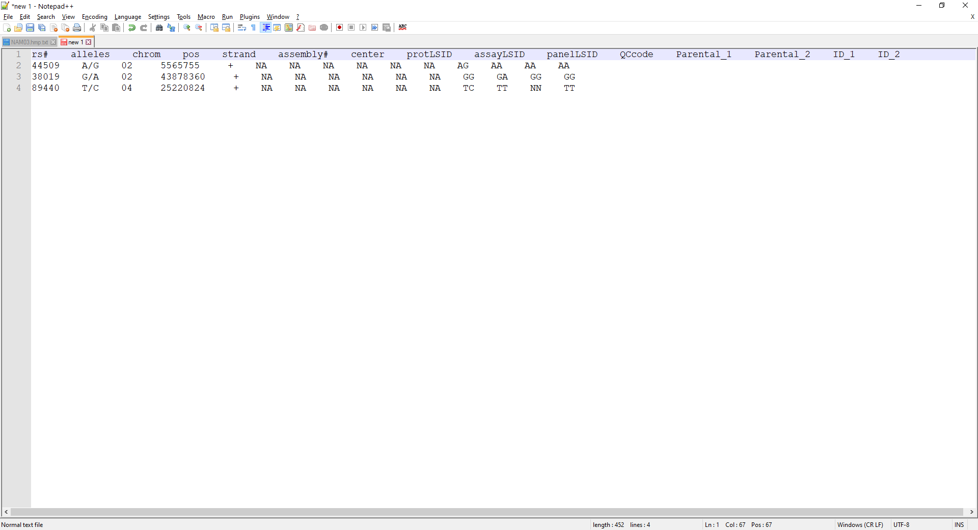
Genotype file type – hapmap
xxx.hmp.txt
Can be viewed with NotePad++
Hapmap (haplotype map)
11 columns
Individual 1, 2 …
SNP ID
REF/ALT
Notes:
Originally developed for the “Hapmap” Project

Slide 16
Genotype file type – hapmap
Hapmap (haplotype map)
11 columns
Code | Meaning
A | Adenine
C | Cytosine
G | Guanine
T | Thymine
R | A or G
Y | C or T
S | G or C
W | A or T
K | G or T
M | A or C
B | C or G or T
D | A or G or T
H | A or C or T
V | A or C or G
N | any base
Individual 1, 2 …
SNP ID
REF/ALT
http://augustogarcia.me/statgen-esalq/Hapmap-and-VCF-formats-and-its-integration-with-onemap/

Slide 17
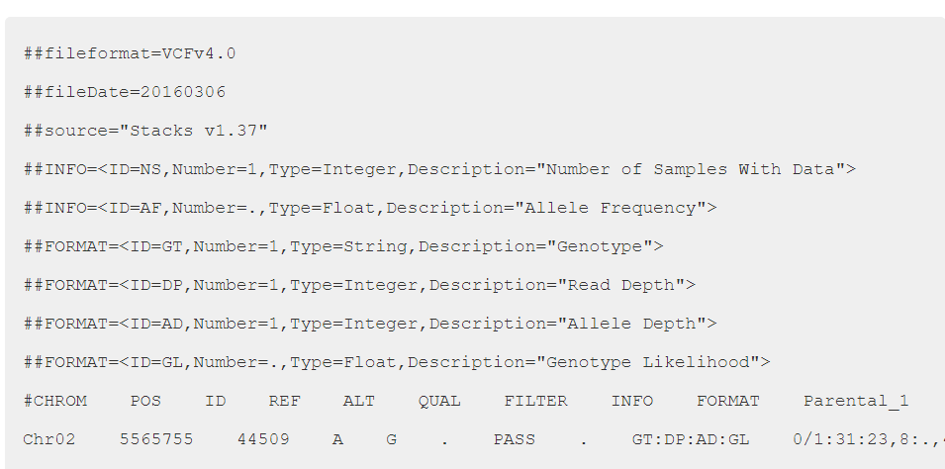
Genotype file type – VCF
xxx.vcf
Can be viewed with NotePad++
Meta-information line
Header line
Data lines
Notes:
Developed for the 1000 Genomes Project

Slide 18

hapmap
VCF

Slide 19
hapmap
VCF

Slide 20
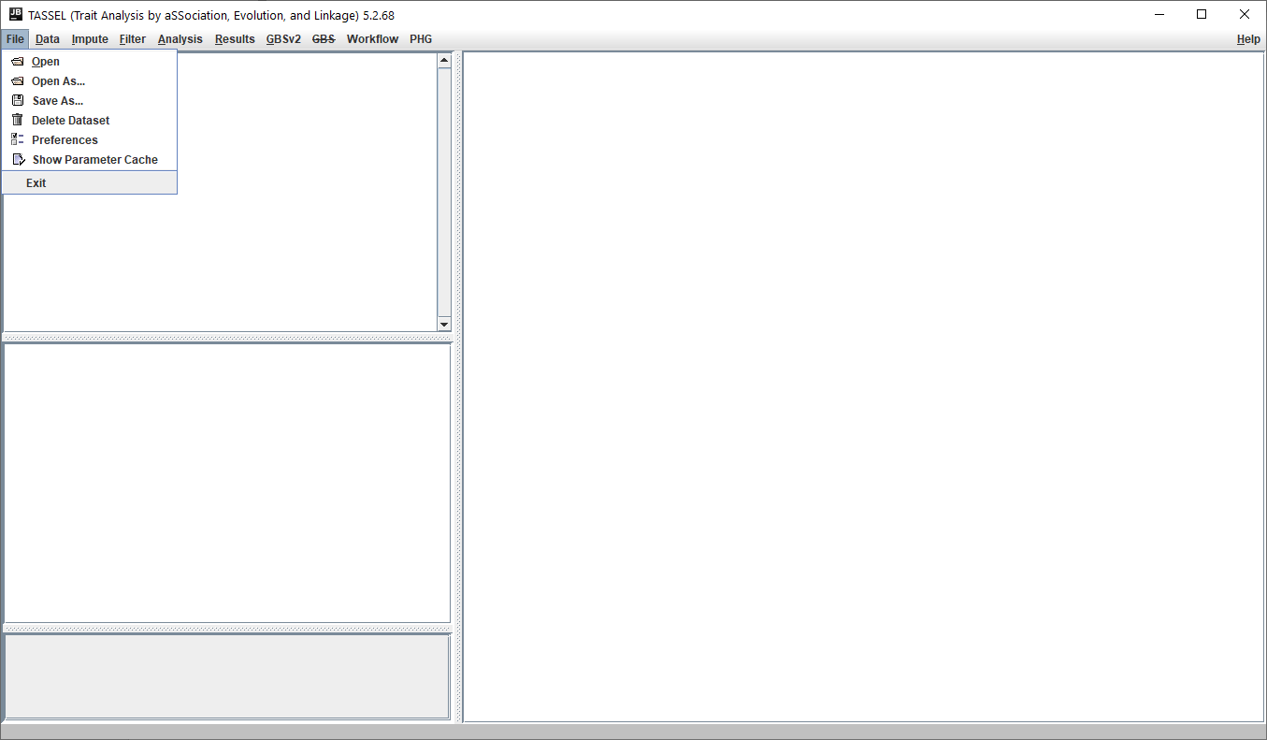
Step 1. Open file in a supported format, e.g., hmp.txt
Step 2. Save an opened file in another supported format, e.g., .vcf
Demo & practice

Slide 21

When converting hapmap to VCF, or hapmap to hapmap, TASSEL would reassign ref/alt based on allele frequency.
If correct ref/alt alleles matter for you, then provide TASSEL with a VCF file instead.
hapmap
VCF
REF ALT
G A
G A
C T

Slide 22

VCF
hapmap

Slide 23
VCF
hapmap
Use caution

Slide 24
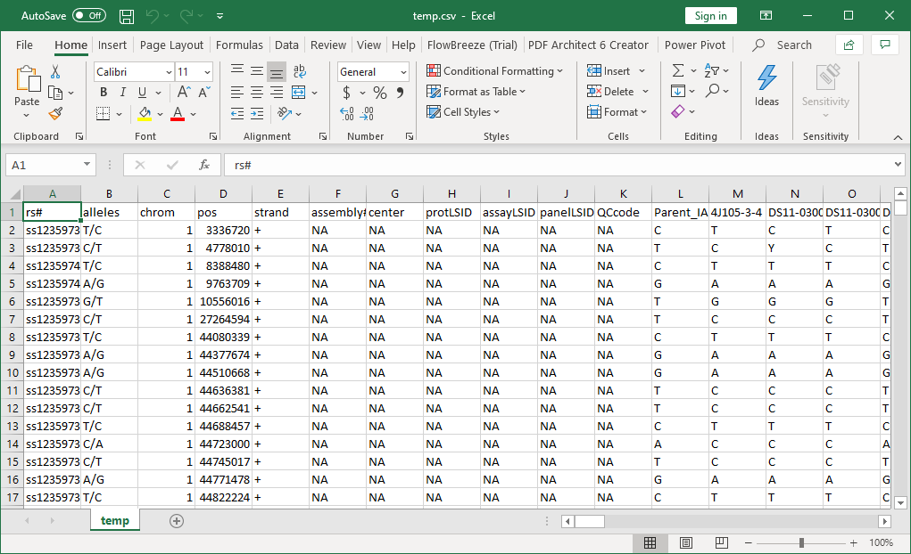
What if you don’t have hapmap or VCF file?
To generate hapmap file manually, you can create a csv file containing columns required by hapmap, then save the .csv file into a .txt file with the name xxx.hmp.txt
save as
e.g. temp.hmp.txt

Slide 25
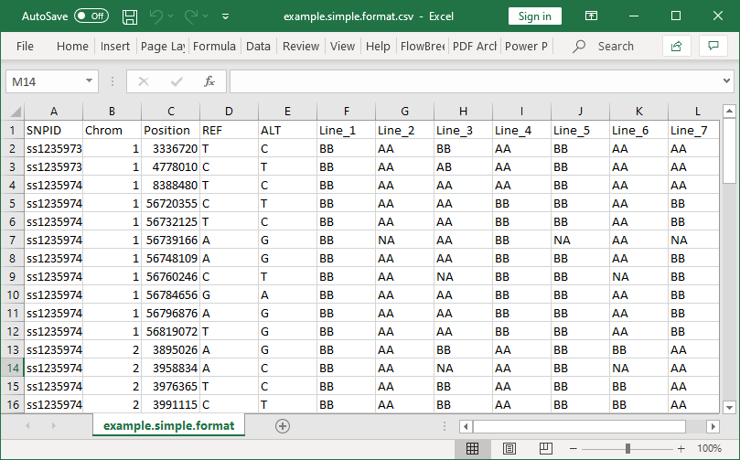
What if you don’t have hapmap or VCF file?
R functions
SimpleToHap()
hmp.txt
SimpleToVCF()
.vcf
Demo in the end

Slide 26
Questions?

Slide 27
Imputation

Slide 28
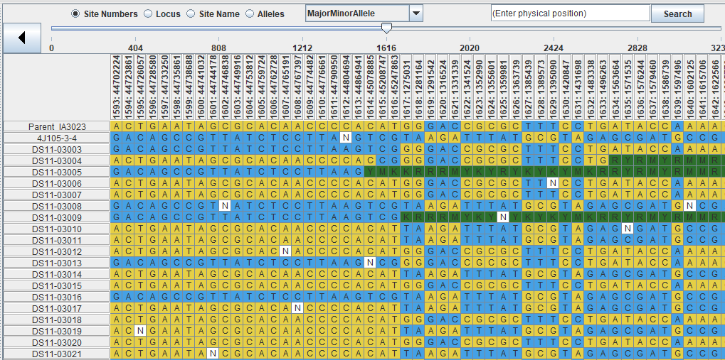
Why imputation
It’s common to have missing genotypic data
Missing genotypes are not allowed in some analysis tools (e.g., genomic selection)
Accurate imputation allows a higher marker density → accuracy for association mapping, genomic selection, etc.

Slide 29
Imputation algorithms in TASSEL
Data imputation
LD KNNi
Numerical
by mean
k-nearest-neighbors
FILLIN
FSFHAP

Slide 30
Imputation algorithms in TASSEL
Data imputation
LD KNNi
Numerical
by mean
k-nearest-neighbors
FILLIN
FSFHAP
K-nearest neighbor approach
Fast
Simple to use
Unordered markers
No physical or genetic maps are required

Slide 31
Imputation algorithms in TASSEL
Data imputation
LD KNNi
Numerical
by mean
k-nearest-neighbors
FILLIN
FSFHAP

Slide 32
Imputation algorithms in TASSEL
Data imputation
LD KNNi
Numerical
by mean
k-nearest-neighbors
FILLIN
FSFHAP
Beagle

Slide 33
Impute with LD KNNi
How to impute
How to calculate accuracy

Slide 34
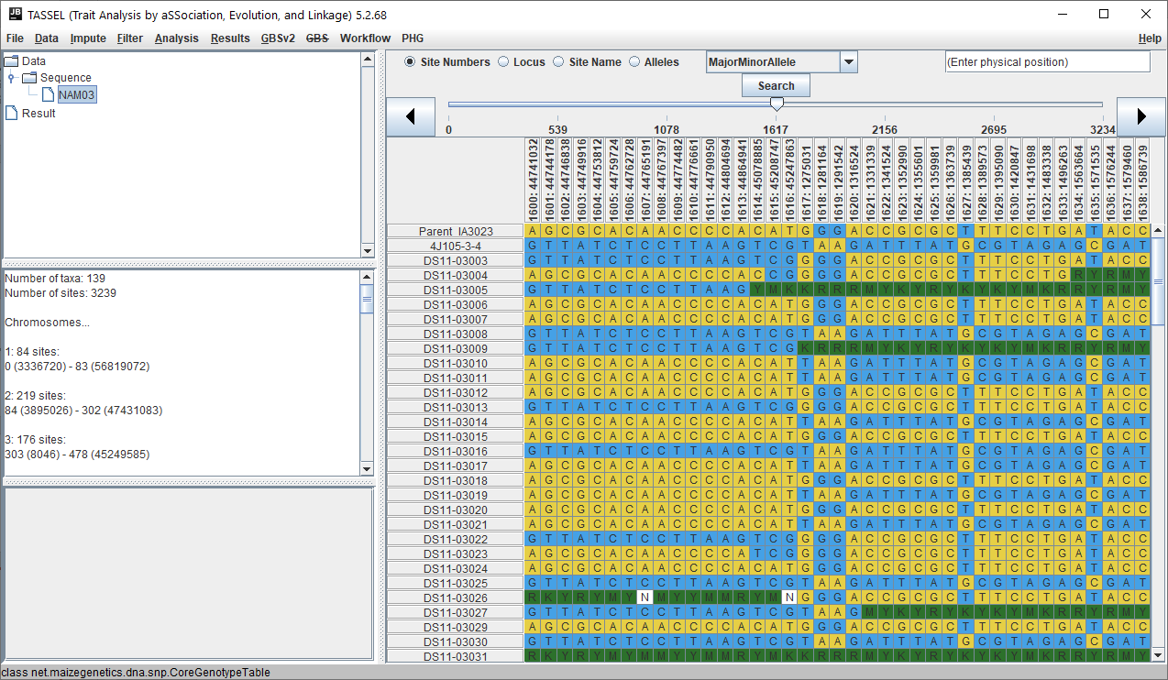
Step 1. Open a genotype file

Slide 35
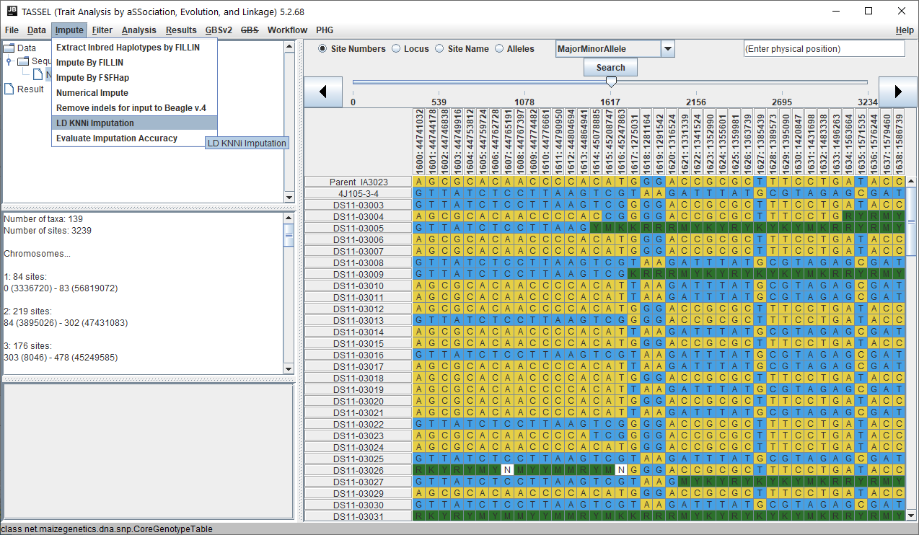
Step 2. Choose LD KNNi under Impute

Slide 36
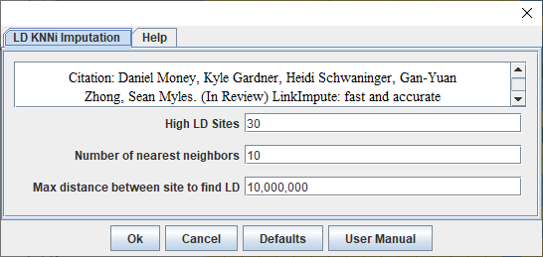
Step 3. Set parameters, click OK
Demo & practice

Slide 37
Calculate imputation accuracy
Step 1. Open a genotype file

Slide 38
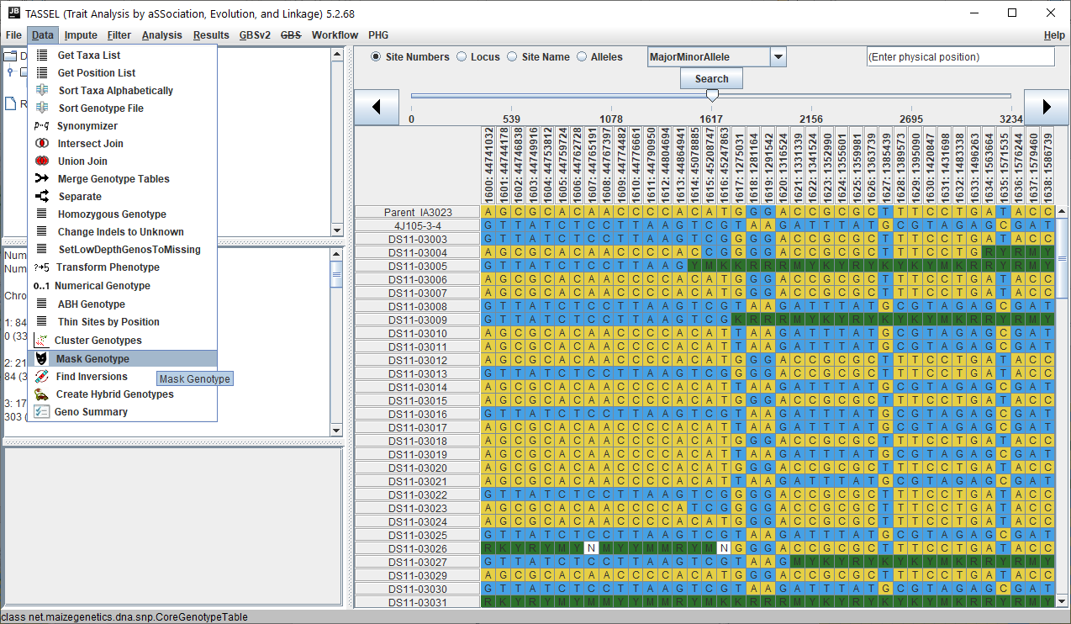
Calculate imputation accuracy
Step 2. Mask genotype

Slide 39
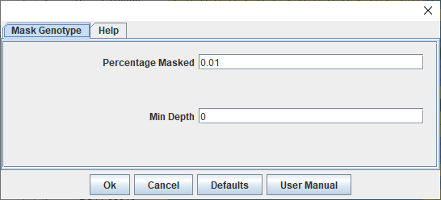
Calculate imputation accuracy
Step 2. Mask genotype

Slide 40
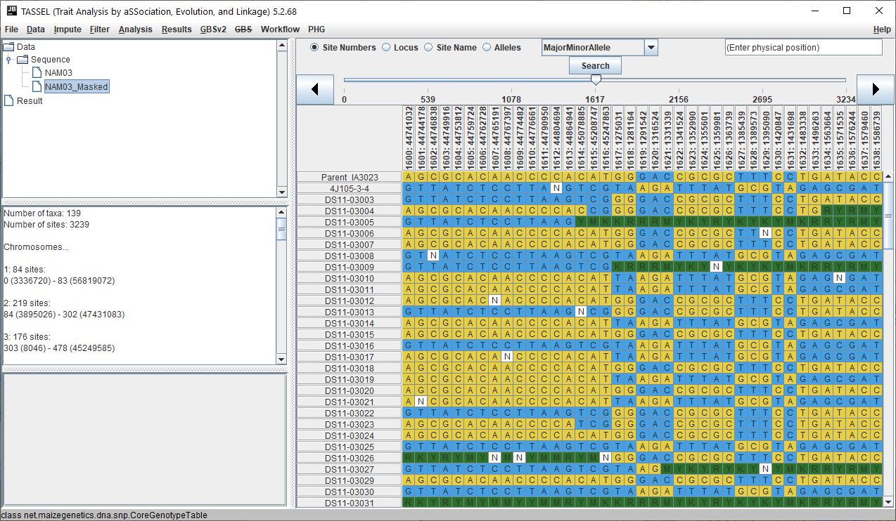
Calculate imputation accuracy
Step 2. Mask genotype

Slide 41
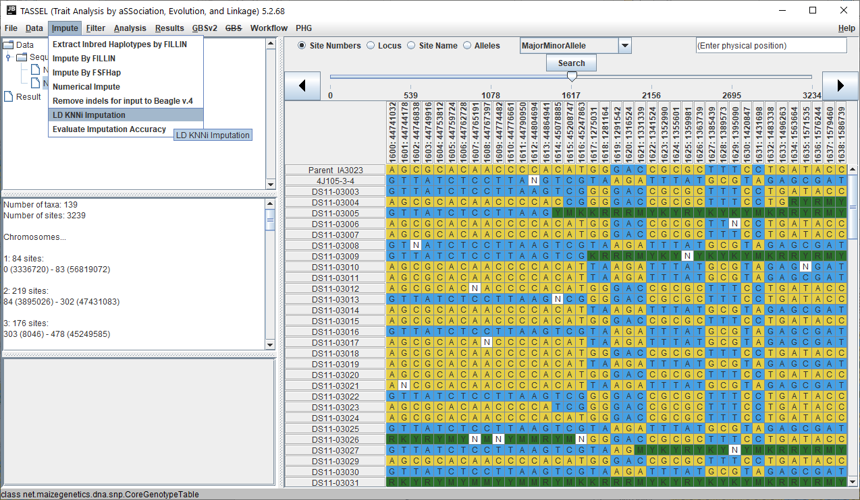
Calculate imputation accuracy
Step 3. Impute masked data

Slide 42
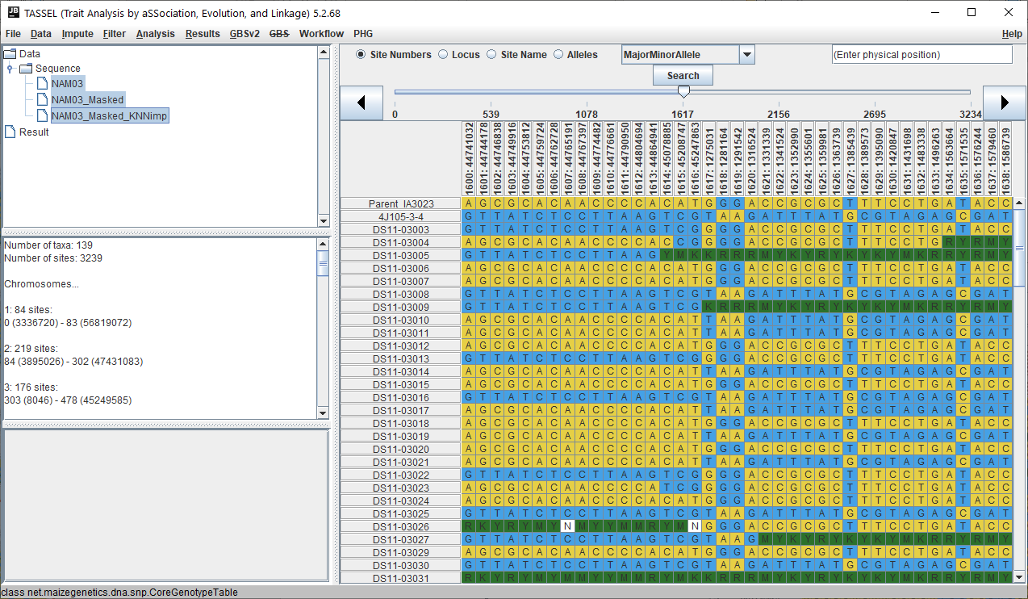
Calculate imputation accuracy
Step 3. Impute masked data

Slide 43
Calculate imputation accuracy
Step 4. Calculate accuracy

Slide 44
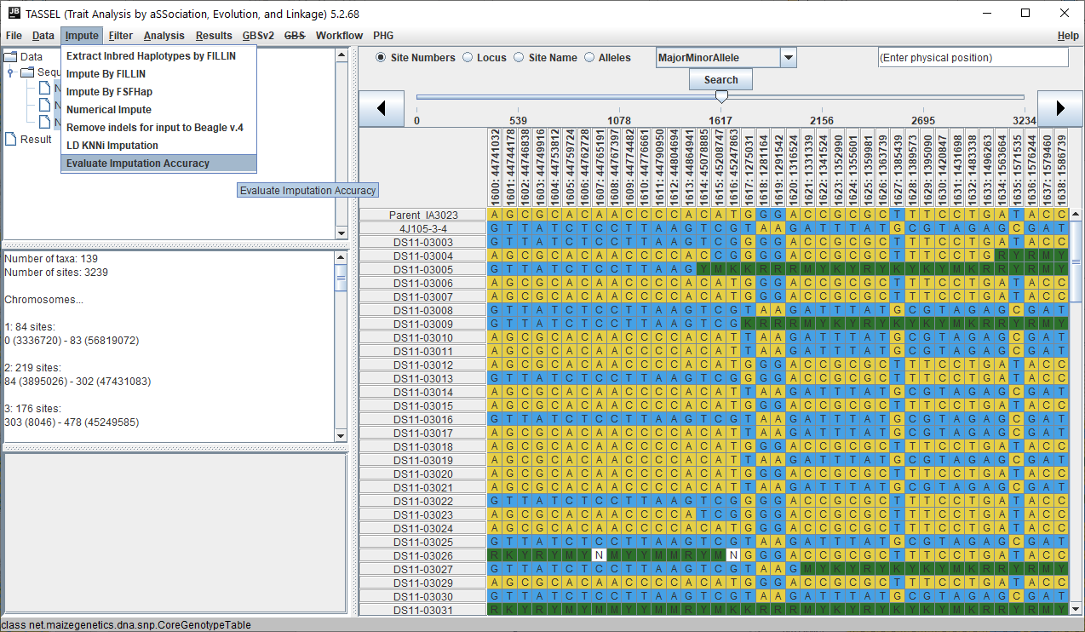
Calculate imputation accuracy
Step 4. Calculate accuracy

Slide 45
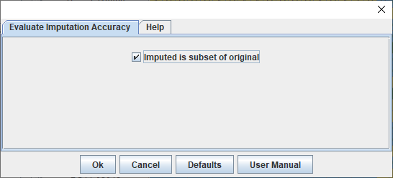
Calculate imputation accuracy
Step 4. Calculate accuracy

Slide 46
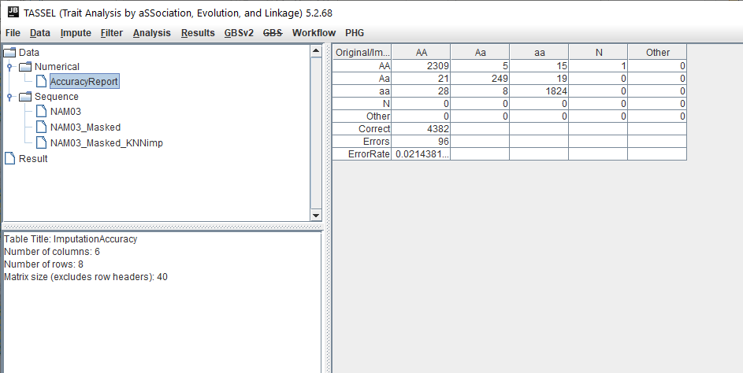
Calculate imputation accuracy
Step 4. Calculate accuracy
Demo & practice

Slide 47
TASSEL in terminal

Slide 48
Before using command line, remember to add TASSEL to PATH
Convert hmp to vcf
run_pipeline.pl -h example.hmp.txt -export TASSEL.vcf -exportType VCF
input file type name
output file name
output file type

Slide 49
Before using command line, remember to add TASSEL to PATH
Convert hmp to vcf
run_pipeline.pl -h example.hmp.txt -export TASSEL.vcf -exportType VCF
input file type name
output file name
output file type
Convert vcf to hmp
run_pipeline.pl -vcf example.vcf -export TASSEL.hmp.txt -exportType Hapmap
input file type name
output file name
output file type

Slide 50
Before using command line, remember to add TASSEL to PATH
Convert hmp to vcf
run_pipeline.pl -h example.hmp.txt -export TASSEL.vcf -exportType VCF
input file type name
output file name
output file type
Convert vcf to hmp
run_pipeline.pl -vcf example.vcf -export TASSEL.hmp.txt -exportType Hapmap
input file type name
output file name
output file type
Impute with LD KNNi
run_pipeline.pl -vcf TASSEL.vcf -LDKNNiImputationPlugin -endPlugin -export TASSEL.imputed.vcf -exportType VCF
input file type, name Imputation tool outputfile name, type

Slide 51
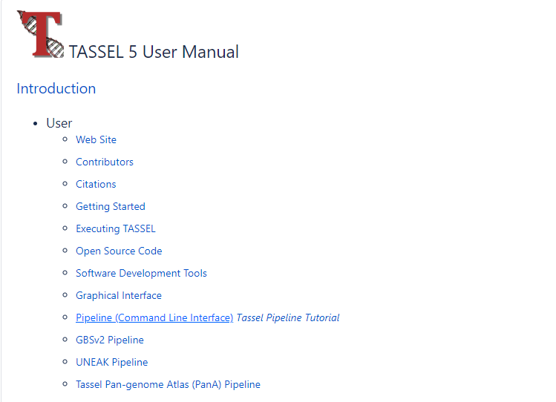
Command Line Tutorial
https://bytebucket.org/tasseladmin/tassel-5-source/wiki/docs/Tassel5PipelineCLI.pdf

Slide 52
Linkage Disequilibrium (LD)
Defined as non-random association between alleles at separate loci
Measured as allelic correlations over physical distance
Physical linkage and recombination affect LD yet unlinked loci can be in LD
Unlinked and far-apart alleles can also have high LD
Species with faster LD decay require higher marker density to discover associations

Slide 53
PCA, kinship
PCA = principal component analysis; a widely-used method that uses markers to determine population stratification
STRUCTURE is another popular program used to assess population stratification (Q matrix)
PCA is much faster and computationally not demanding
Kinship = measure of family relatedness, also using markers

Slide 54
GLM, MLM
GLM = general linear model = fixed effect only, no random effect used as covariate to control for population structure
MLM = mixed linear model = fixed and random effect
Tassel’s GLM uses either PCA (or MDS) or STRUCTURE’s Q matrix as fixed effect
MLM allows PCA+Q (STRUCTURE) and PCA+K (kinship) = better control of Type I error though model over-fitting may occur
Both are single-locus models, i.e. one marker tested at a time
Complex traits are however controlled by multiple genes/loci
Multi-loci models exist but not in Tassel: FarmCPU is a well-known example, mrMLM

Slide 55
QQ plots
Shows the expected negative-log of association probability (X-axis) across all markers versus the observed negative-log of association probability values (Y-axis)
A straight line without any tail indicates a uniform distribution => no significant association
No straight line or tail:
False positives if line inflates upward
False negatives when line deflates downward
A straight line with a sharp upward tail: both false positives and false negatives were controlled, and true associations/causal polymorphisms are present
[Why? P-values that do not follow uniform distribution (i.e. due to causal loci) are of very small magnitude and are located in the tail]

Slide 56
VIM
https://www.vim.org/download.php

